Slide 1

W3C Web of Things Introduction, Status, and Roadmap
24 October 2018

Slide 2





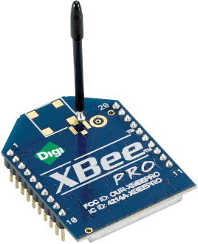
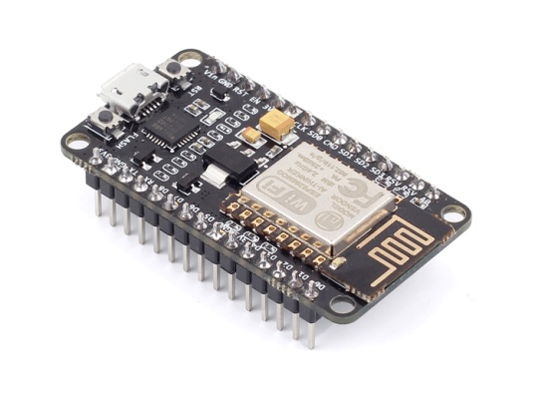
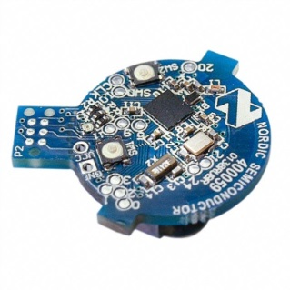
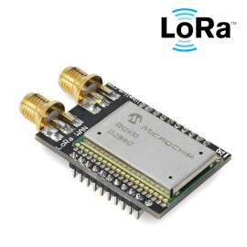

Web of Things in a Nutshell
Web of Things (WoT): Applications
Horizontal application layer for the IoT similar to the World Wide Web for the Internet
…
Internet of Things (IoT): Connectivity
: Connectivity
…
Ethernet
LPWAN (LoRa, Sigfox, NB-IoT, …)
Wi-Fi
IEEE 802.15.4 (ZigBee/6LoWPAN/Thread)
Bluetooth

Slide 3



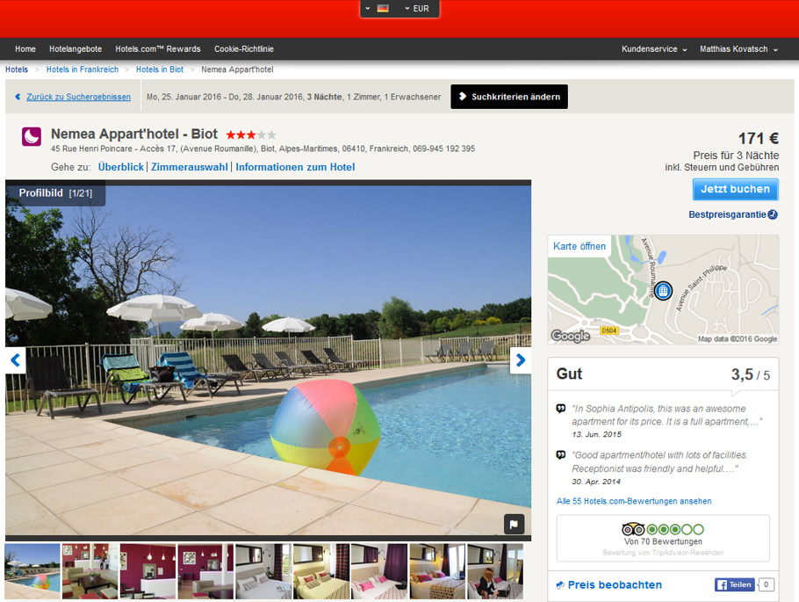




Why the Web – User- and Developer-friendly
Profiles 30,308
Internet of Things
Domain expertise
Embedded developers
Optimized protocols and formats
Silos with high integration costs
World Wide Web
Interoperability and usability
Web developer community
HTTP, JSON, scripting
Easy with high productivity
Web of Things
Take patterns that worked for the Web
Adapt and apply them to the IoT
Open source culture
Profiles 873,202
Notes:
Add figure of developer profiles (80-20 story)
Hotels mashup

Slide 4


Web of Things – a W3C Standardization Activity
Academic Community http://www.webofthings.org/
Term coined in 2007
International workshop series since 2010
W3C WoT Community Group (CG) No charter needed Chair: Dave Raggett
Started summer 2013
~260 participants
Free discussion (no membership needed)
W3C WoT Workshop, Berlin, 2014
Identify stakeholders for standards work
Believe in benefits of Web technology for IoT
Web standards are horizontal and neutral

Slide 5
Web of Things – a W3C Standardization Activity
W3C WoT Interest Group (IG) https://www.w3.org/2016/07/wot-ig-charter.html Co-chairs: Siemens AG, Huawei
Started spring 2015
~200 participants
Informal work, outreach
“PlugFests” validation with running code
Exploration of new building blocks
“OpenDays” with also external speakers
Liaisons and collaborations with other organizations and SDOs
W3C WoT Working Group (WG) https://www.w3.org/2016/12/wot-wg-2016.html Co-chairs: Siemens AG, Panasonic Corp., Intel Corp.
Started end of 2016 (effectively Feb 2017)
~100 participants
Normative work
Work on deliverables
W3C Patent Policy for royalty-free standards
Only W3C Members and Invited Experts

Slide 6
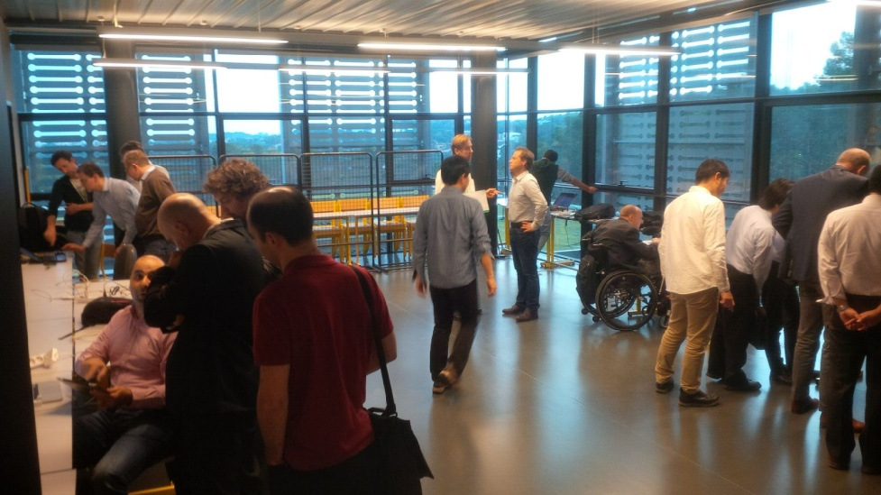
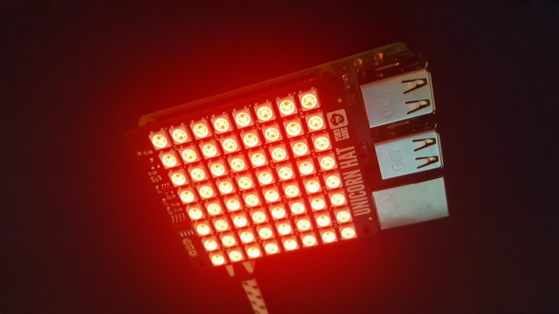
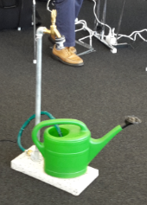
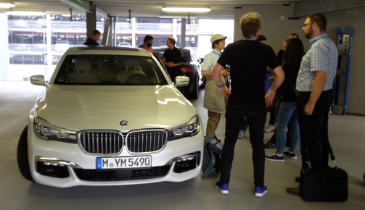
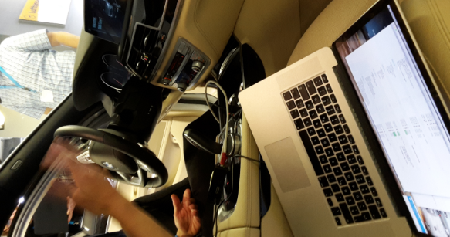
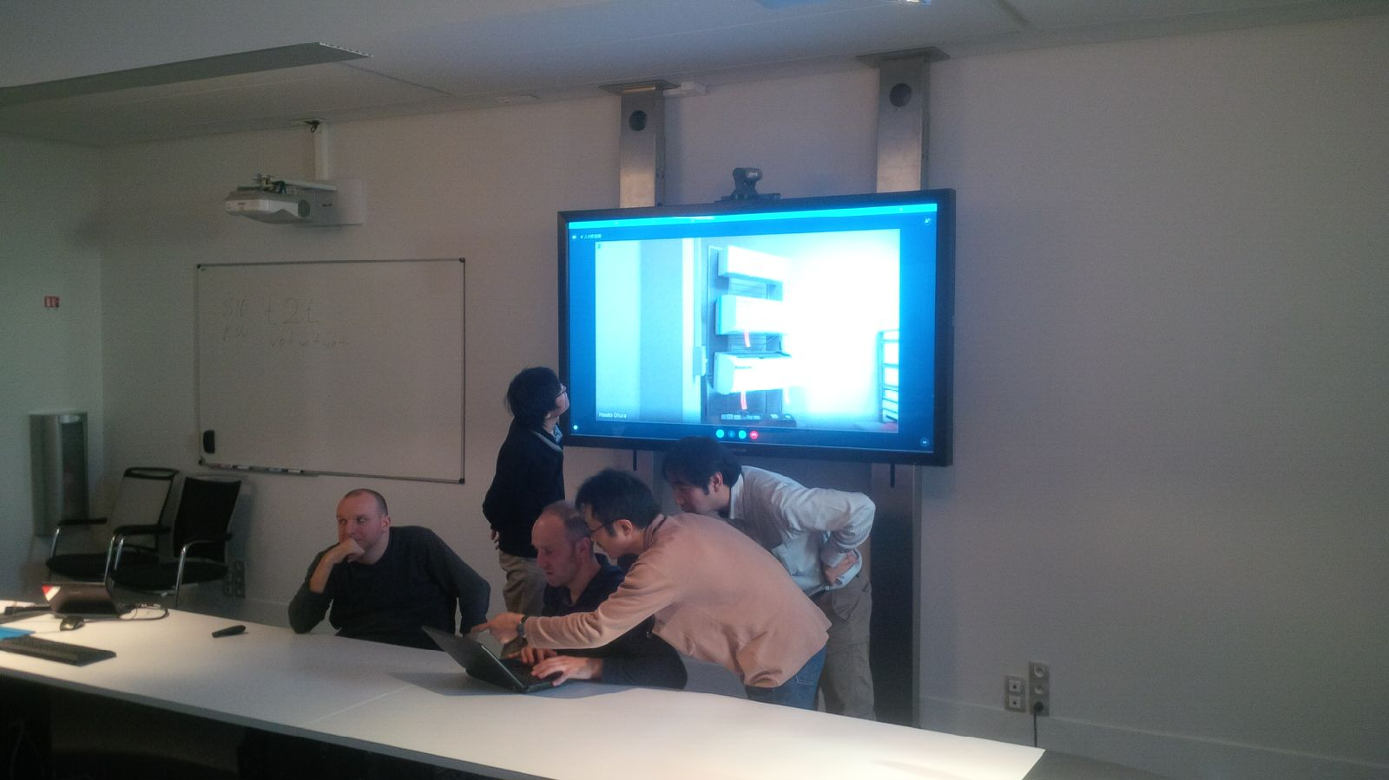
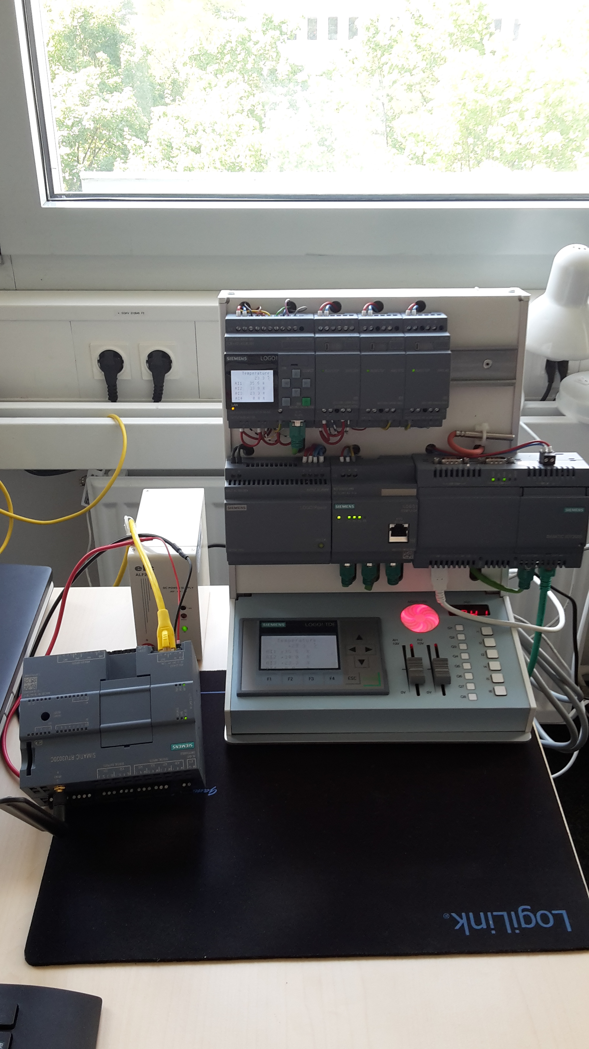
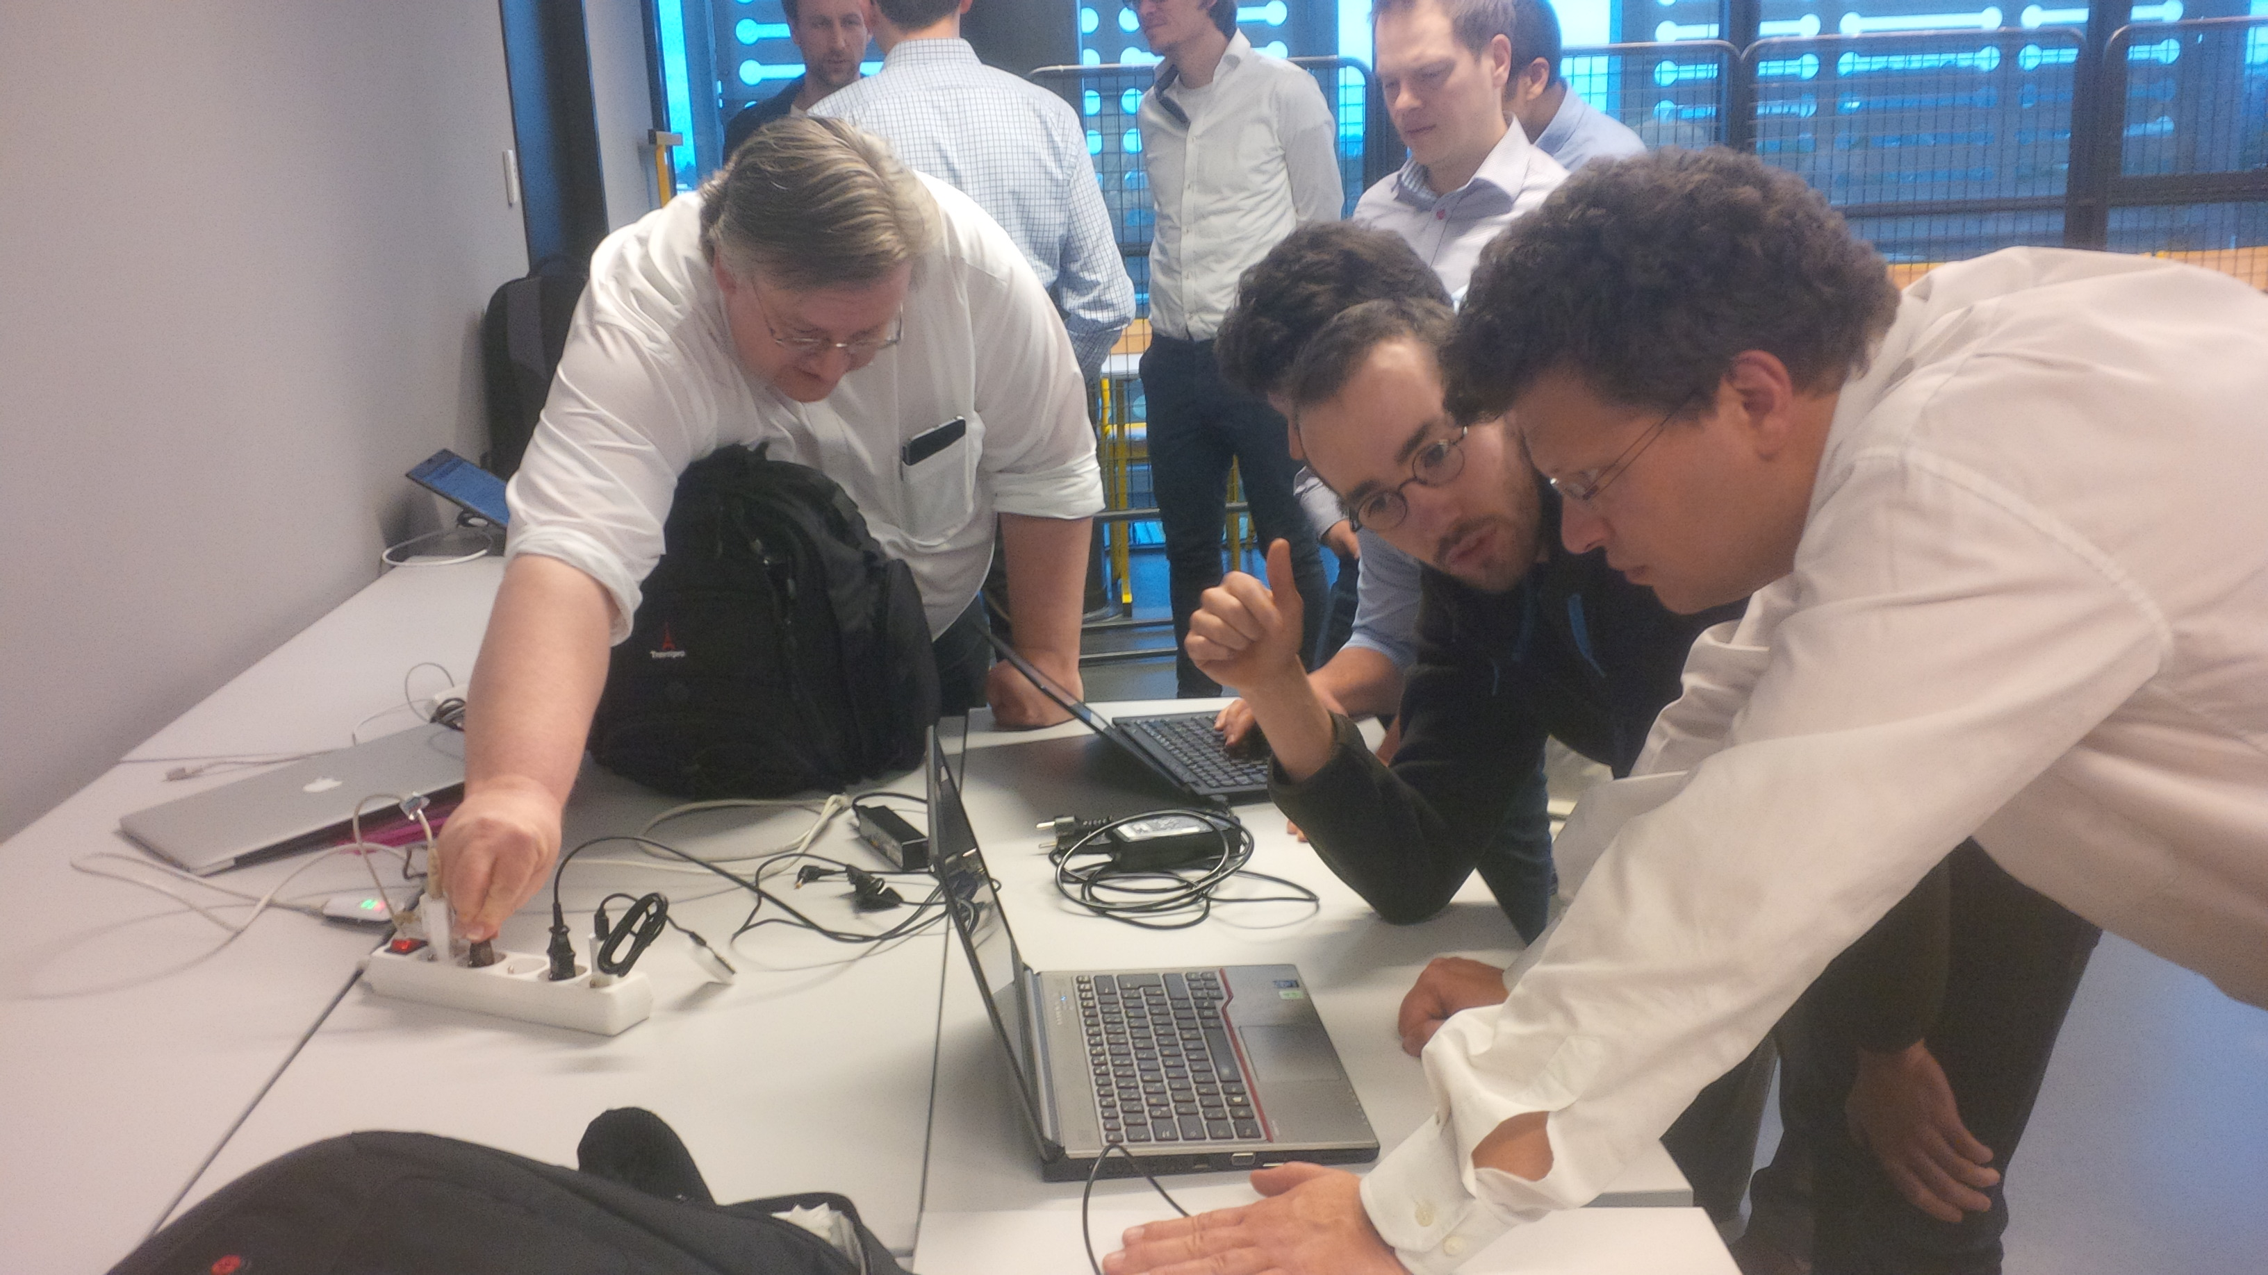
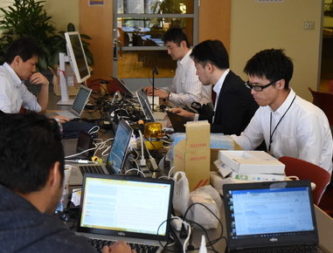
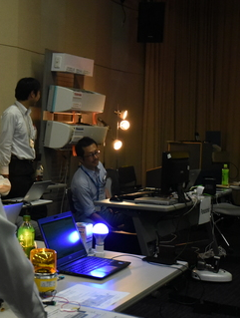
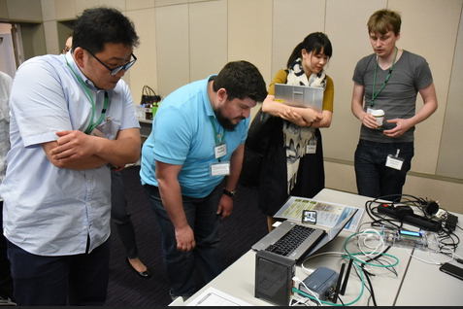
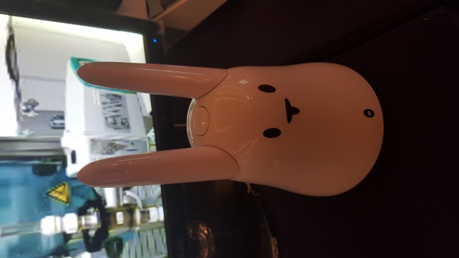
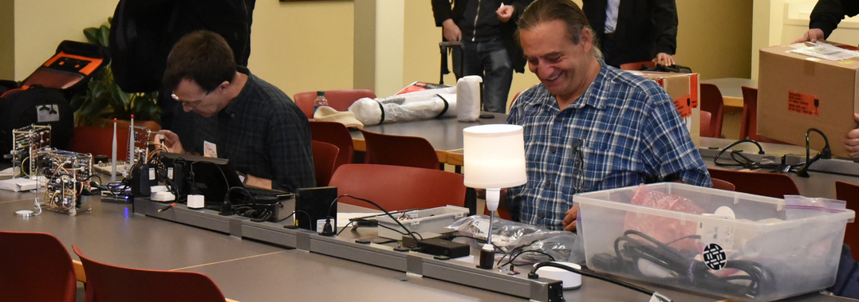
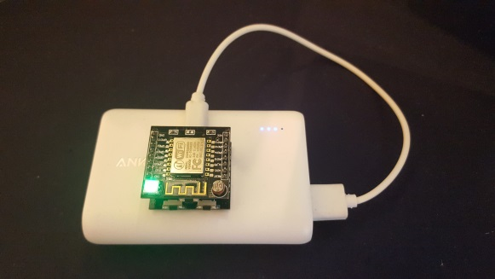
PlugFests to Evaluate Current Working Assumptions

Slide 7

W3C WoT Mission – Not Yet Another IoT Silo

Slide 8

W3C WoT Mission – Describe and Complement
Web of Things: “glue in between”
…

Slide 9





























W3C WoT Member Organizations
Web of Things: “glue in between”
…

Slide 10
W3C WoT Liaisons
IETF
OCF
oneM2M
OPC Foundation
ISO/IEC JTC 1 SC 41
IIC
Hypercat Alliance
AIOTI
The Open Group
Web of Things: “glue in between”
ETSI ISG CIM
Echonet
LWM2M / IPSO
Plattform Industrie 4.0
OpenFog Consortium
Fairhair Alliance
BACnet
Modbus
Official W3C Liaison
Collaborations / calls
Implementations
https://www.w3.org/2001/11/StdLiaison

Slide 11
W3C WoT Approach – Building Blocks
Provide semantic metadata that uniformly describes how to interact with Things
Define a common runtime for IoT applications that mimics Web development
Any IoT Device
Application
Every SDK and library is different,
so that app development is expensive
SDK
Data Model
Form an implicit interaction model,
which is usually not well documented
Capture each protocol once in a uniform template that describes how to configure protocol stacks (e.g., CoAP or MQTT) to send the message expected by the Thing
Protocol
The IoT has a plethora of protocols,
often dialects due to custom options

Slide 12

W3C WoT Approach – Building Blocks
Define a common runtime for IoT applications that mimics Web development
WoT Thing Description (TD)
JSON-LD representation format to describe Thing instances with metadata. Uses formal interaction model and domain-specific vocabularies to uniformly describe how to use Things, which enables semantic interoperability.
Any IoT Device
Application
Every SDK and library is different,
so that app development is expensive
SDK
The index.html
for Things
Interaction Model
Capture each protocol once in a uniform template that describes how to configure protocol stacks (e.g., CoAP or MQTT) to send the message expected by the Thing
Properties
Protocol
Actions
Events
The IoT has a plethora of protocols,
often dialects due to custom options

Slide 13
WoT Thing Description (TD) – JSON-LD Documents
{
"@context": [
"https://w3c.github.io/wot/w3c-wot-td-context.jsonld",
{ "iot": "http://iotschema.org/" }
],
"id": "urn:dev:org:32473:1234567890",
"name": "MyLEDThing",
"description": "RGB LED torchiere",
"@type": ["Thing", "iot:Light"],
"security": [{
"scheme": "oauth2",
"authenticationUrl": "https://authority-issuing.example.org"
}],
"properties": {
"brightness": {
"type": "integer",
"minimum": 0,
"maximum": 100,
"@type": ["iot:Brightness"],
"iot:Unit": "iot:Percent",
"writeable": true, "forms": [ ... ]
}
},
"actions": {
"fadeIn": {
JSON-LD (Linked Data)
Converts to RDF triples
W3C WoT TD vocabulary
Domain-specific vocabulary
Security Metadata
JSON Schema
Compatible
data schemas
Optional semantic types
Protocol
Bindings
Extended metadata using domain-specific
vocabulary

Slide 14
WoT Thing Description (TD) – Minimal form
No semantic annotations
{
"id": "urn:dev:org:32473:1234567890",
"name": "MyLEDThing",
"description": "RGB LED torchiere",
"security": [{
"scheme": "oauth2",
"authenticationUrl": "https://authority-issuing.example.org"
}],
"properties": {
"brightness": {
"type": "integer",
"minimum": 0,
"maximum": 100,
"writeable": true, "forms": [ ... ]
}
},
"actions": {
"fadeIn": {
"input": {
"type": "object",
"properties": {
"target": {
"type": "integer",
"minimum": 0,
"maximum": 100,
},
"output": {
},
Media Type application/td+json identifies document as TD so
TD context and vocabulary apply as default

Slide 15
W3C WoT Approach – Building Blocks
Define a common runtime for IoT applications that mimics Web development
WoT Thing Description (TD)
JSON-LD representation format to describe Thing instances with metadata. Uses formal interaction model and domain-specific vocabularies to uniformly describe how to use Things, which enables semantic interoperability.
Any IoT Device
Application
Every SDK and library is different,
so that app development is expensive
SDK
The index.html
for Things
Interaction Model
Capture each protocol once in a uniform template that describes how to configure protocol stacks (e.g., CoAP or MQTT) to send the message expected by the Thing
Properties
Protocol
Actions
Events
The IoT has a plethora of protocols,
often dialects due to custom options

Slide 16
W3C WoT Approach – Building Blocks
Define a common runtime for IoT applications that mimics Web development
WoT Thing Description (TD)
JSON-LD representation format to describe Thing instances with metadata. Uses formal interaction model and domain-specific vocabularies to uniformly describe how to use Things, which enables semantic interoperability.
Any IoT Device
Application
Every SDK and library is different,
so that app development is expensive
SDK
The index.html
for Things
Interaction Model
Properties
Bindings
WoT Binding Templates
Actions
Capture how the formal Interaction Model is mapped to concrete protocol operations (e.g., CoAP) and platform features (e.g., OCF). These templates are re-used by concrete TDs.
Events
HTTP
CoAP
MQTT
…
UA Binary
Modbus
BACnet

Slide 17
WoT Binding Templates – Instantiated in TDs
...
"properties": {
"brightness": {
... "forms": [
{ // Defaults: GET to read, PUT to write
"href": "https://myled.example.com:8080/pwr",
"mediaType": "application/json"
}
]
}
},
"actions": {
"fadeIn": {
...
"forms": [
{
"href": "coaps://myled.example.com:5684/pwr",
"mediaType": "application/ocf+cbor",
"coap:methodCode": 3, // PUT instead of POST to invoke
"coap:options": [ {
"coap:optionNumber": 2053, // OCF-Content-Format-Version
"coap:optionValue": "1.1.0"
} ]
}
]
Basics to build the request
Deviation from defaults
Notes:
coap:methodCode = PUT
coap:optionNumber 2053 = OCF-Content-Format-Version

Slide 18
W3C WoT Approach – Building Blocks
Define a common runtime for IoT applications that mimics Web development
WoT Thing Description (TD)
JSON-LD representation format to describe Thing instances with metadata. Uses formal interaction model and domain-specific vocabularies to uniformly describe how to use Things, which enables semantic interoperability.
Any IoT Device
Application
Every SDK and library is different,
so that app development is expensive
SDK
The index.html
for Things
Interaction Model
Properties
Bindings
WoT Binding Templates
Actions
Capture how the formal Interaction Model is mapped to concrete protocol operations (e.g., CoAP) and platform features (e.g., OCF). These templates are re-used by concrete TDs.
Events
HTTP
CoAP
MQTT
…
UA Binary
Modbus
BACnet

Slide 19
W3C WoT Approach – Building Blocks
JavaScript
WoT Thing Description (TD)
WoT Scripting API
JSON-LD representation format to describe Thing instances with metadata. Uses formal interaction model and domain-specific vocabularies to uniformly describe how to use Things, which enables semantic interoperability.
Standardized JavaScript object API for an IoT runtime system similar to the Web browser. Provides an interface between applications and Things to simplify IoT application development and enable portable apps across vendors, devices, edge, and cloud.
Any IoT Device
Common Runtime
Application Script
Scripting API
The index.html
for Things
Interaction Model
Data Model
Properties
Bindings
WoT Binding Templates
Actions
Capture how the formal Interaction Model is mapped to concrete protocol operations (e.g., CoAP) and platform features (e.g., OCF). These templates are re-used by concrete TDs.
Events
HTTP
CoAP
MQTT
…
UA Binary
Modbus
BACnet

Slide 20
WoT Scripting API – Browser-like Runtime for IoT
Servient
Can be client only, i.e., consume Things only
Can expose multiple Things
Application A
Application B
Security Metadata
Security Metadata
Executes scripts,
generates TDs,
parses TDs to software objects
WoT Scripting API
WoT Runtime
Protocol Bindings
System API
Generic protocol stacks that can be configured
HTTP(S)
CoAP(S)
Local Hardware
Proprietary Communi- cation
…
MQTT
Notes:
Like Ajax API: GeoLocation for ‚sensor‘ and vibrtion for ‚actuator‘

Slide 21
W3C WoT Approach – Building Blocks
JavaScript
WoT Thing Description (TD)
WoT Scripting API
JSON-LD representation format to describe Thing instances with metadata. Uses formal interaction model and domain-specific vocabularies to uniformly describe how to use Things, which enables semantic interoperability.
Standardized JavaScript object API for an IoT runtime system similar to the Web browser. Provides an interface between applications and Things to simplify IoT application development and enable portable apps across vendors, devices, edge, and cloud.
Any IoT Device
Common Runtime
Application Script
Scripting API
The index.html
for Things
Interaction Model
Data Model
Properties
Bindings
WoT Binding Templates
Actions
Capture how the formal Interaction Model is mapped to concrete protocol operations (e.g., CoAP) and platform features (e.g., OCF). These templates are re-used by concrete TDs.
Events
HTTP
CoAP
MQTT
…
UA Binary
Modbus
BACnet

Slide 22
W3C WoT Approach – Batteries Included
JavaScript
WoT Thing Description (TD)
WoT Scripting API
JSON-LD representation format to describe Thing instances with metadata. Uses formal interaction model and domain-specific vocabularies to uniformly describe how to use Things, which enables semantic interoperability.
Standardized JavaScript object API for an IoT runtime system similar to the Web browser. Provides an interface between applications and Things to simplify IoT application development and enable portable apps across vendors, devices, edge, and cloud.
Any IoT Device
WoT Security and Privacy metadata and guidelines for existing security (e.g., IETF ACE)
Common Runtime
Application Script
Scripting API
The index.html
for Things
Interaction Model
Data Model
Properties
Bindings
WoT Binding Templates
Actions
Capture how the formal Interaction Model is mapped to concrete protocol operations (e.g., CoAP) and platform features (e.g., OCF). These templates are re-used by concrete TDs.
Events
HTTP
CoAP
MQTT
…
UA Binary
Modbus
BACnet

Slide 23
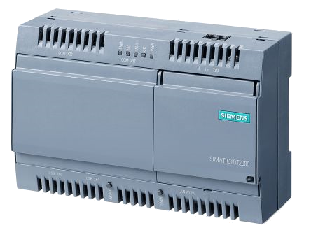

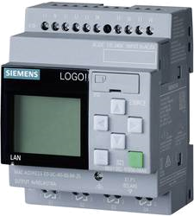

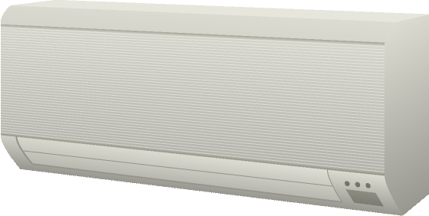
W3C WoT Integration Patterns – Things AND Cloud
Cloud
Servient
Edge
Digital Twiin
Servient
Orchestr. Client
Digital Twiin
Virtual Thing
Scripting API
Orchestr. Client
Interaction Model
Proxy Thing
Bindings
Remote Access and Synchronization
Scripting API
Interaction Model
Bindings
Web Browser
Integrate and Orchestrate Devices
App Script
Direct Thing-to-Thing
Interaction
Scripting API
Interaction Model
Bindings
Thing
Constr. Thing
Existing Device
Web Integration
Application Logic
Classic Firmware
Scripting API
+
Interaction Model
Interaction Model
⇒
Bindings
Protocol
Complement Existing Devices
Thing

Slide 24
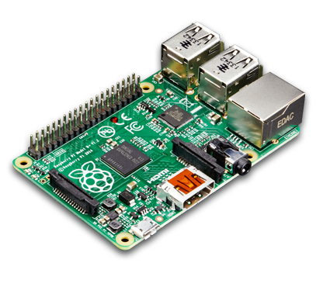
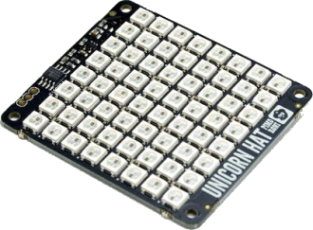
Deployment Scenarios – Basic Client-Server
WoT Client
Servient on Device
Client Script
Thing Script
Security Metadata
WoT Scripting API
WoT Scripting API
WoT Runtime
WoT Runtime
Protocol Bindings
Protocol Bindings
System API
HTTP(S)
CoAP(S)
HTTP(S)
CoAP(S)
Local Hardware
MQTT
…
…
MQTT

Slide 25
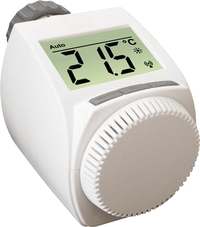
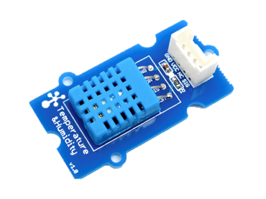
Deployment Scenarios – Constrained Devices
WoT Client
Device Firmware
Native Code
Client Script
WoT Scripting API
WoT Runtime
Protocol Bindings
Protocol
Driver API
HTTP(S)
CoAP(S)
CoAP(S)
Local Hardware
MQTT
…

Slide 26
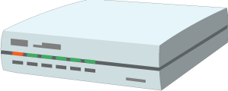

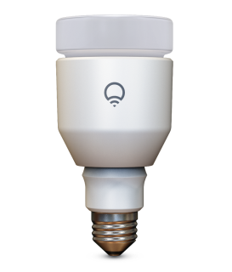
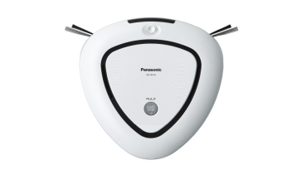
Deployment Scenarios – Web Integration
Servient in Browser
Servient on Cloud
Servient on Gateway
Application Script
Mirror Script
Integration Script
Security Metadata
Security Metadata
WoT Scripting API
WoT Scripting API
WoT Scripting API
Browser + Polyfill
WoT Runtime
WoT Runtime
Protocol Bindings
Protocol Bindings
Protocol Bindings
System API
HTTP(S)
(S)RTP
HTTP(S)
CoAP(S)
HTTP(S)
CoAP(S)
Local Hardware
Proprietary Communi- cation
…
FTP
MQTT
…
MQTT
…
Thing
Legacy Device
Servient

Slide 27
Status and Recent Developments
Decision to adopt JSON-LD 1.1 proposed features to allow:
Default values
Object name:value notation
Generally: more similarity to standard JSON practices
Support for "minimal" TD without semantics
Both of the above based on "preprocessing" to convert to JSON-LD 1.0
Avoiding actual dependency on JSON-LD 1.1 updated standard
Security metadata
Focus on HTTP(S), CoAP(S) and MQTT(S)
Protocol Bindings
Focus on HTTP, CoAP, and MQTT and structured payloads compatible with JSON
Support for Observe, using subProtocols (eg long polling in HTTP) when appropriate

Slide 28
Roadmap
Have requested 6-month extension to June 2019
In order to complete substantial changes required due to JSON-LD 1.1
Converge with Mozilla Web Things proposal expected
New features enabled by JSON-LD 1.1 features
Convergence will preserve semantics capabilities for those who want them
Current focus:
Testing and security
WoT WG Charter renewal being discussed; possible new deliverables:
Thing Directory and WoT-aware proxies with standardized APIs
Additional interactions, such as streaming data
Additional protocols and payload types
Extended IoT ontologies (semantics vocabularies)
Updates to converge with JSON-LD 1.1 actual (if necessary)

Slide 29
W3C WoT Summary
Counter fragmentation in the IoT
Web of Things to Internet of Things is similar to the Web to Internet relation
Take patterns from the World Wide Web and adapt and apply them to the IoT
JSON, Schema, and Linked Data
URIs and Media Types
JavaScript runtime
By Describing and Complementing
Not competing with existing IoT standards, as not prescribing a full-stack solution
W3C WoT offers building blocks to pick that enable semantic interoperability
WoT Thing Description (TD)
WoT Binding Templates
WoT Scripting API

Slide 30
W3C WoT Resources
W3C WoT Wiki
https://www.w3.org/WoT/IG/wiki (IG/WG organizational information)
W3C WoT Interest Group
https://www.w3.org/2016/07/wot-ig-charter.html (charter)
https://lists.w3.org/Archives/Public/public-wot-ig/ (mailing list)
https://github.com/w3c/wot (technical proposals)
W3C WoT Working Group
https://www.w3.org/2016/12/wot-wg-2016.html (charter)
https://www.w3.org/WoT/WG/ (dashboard)
W3C WoT Working Drafts
https://www.w3.org/TR/wot-architecture/
https://www.w3.org/TR/wot-thing-description/
https://www.w3.org/TR/wot-binding-templates/
https://www.w3.org/TR/wot-scripting-api/
W3C WoT Editors’ Drafts and Issue Tracker
https://github.com/w3c/wot-architecture/
https://github.com/w3c/wot-thing-description/
https://github.com/w3c/wot-binding-templates/
https://github.com/w3c/wot-scripting-api/
Implementations
https://projects.eclipse.org/projects/iot.thingweb
https://github.com/thingweb/

Slide 31
Contacts
Dr. Michael McCool
Principal Engineer
Intel Corp.
DPD TPI
michael.mccool@intel.com
Dr. Matthias Kovatsch
Senior Research Scientist
Siemens AG
CT RDA IOT EWT-DE
matthias.kovatsch@siemens.com

